Slide 1


Media Delivery Network Simulator
Sponsor - Ericsson Point of contact - Vladimir Katardjiev, Alvin Jude Faculty Advisor - Jia Zhang Team - Jeremy Fu, Jigar Patel, Vinay Kumar Vavili, Hao Wang
INI Project Practicum, Fall 2014

Slide 2
Agenda
Introduction
System Design and Implementation
Demo
System Limitations
Future Work

Slide 3
Introduction
Why media delivery network simulator?

Slide 4
Problem Statement
To build a “life sized” simulation of Internet-based media distribution, with a flexible framework that will allow tinkering, experimentation and evolution.

Slide 5
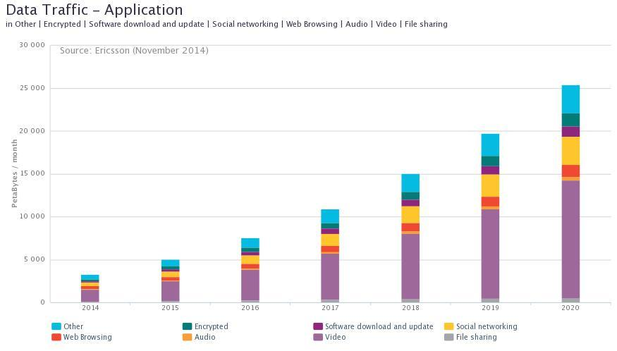
Traffic Forecast
Notes:
The number of IP connected devices that can view video has grown from 200 million (personal computers) to over 1.6 billion in the period 2000-2013 alone. In 2020, there are expected to be 15 billion video-enabled connected devices globally
Global data traffic is expected to grow over 10x by 2020 with video predicted to be 50% of all this traffic
And, in advanced markets, half of content watched is on-demand
[Source: http://www.ericsson.com/televisionary/blog/ericsson-media-vision-2020-game-changer-two-ip-imperative/]

Slide 6
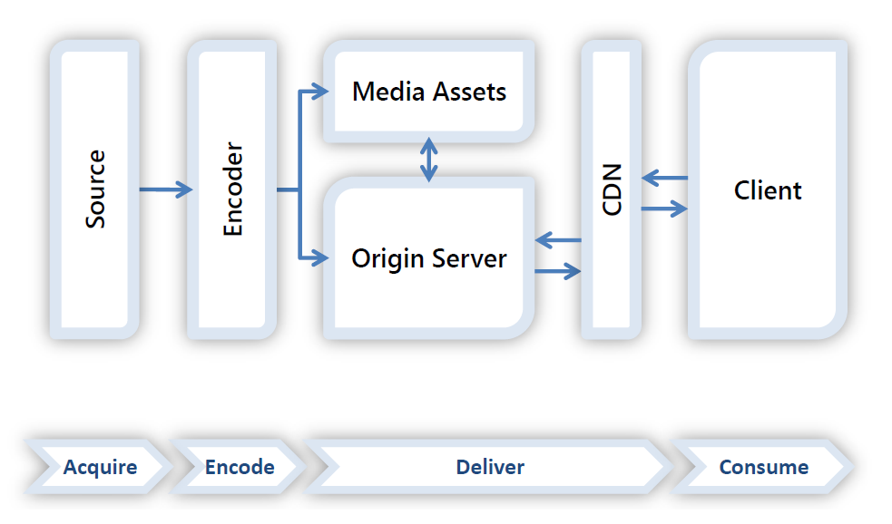
Live media streaming architecture

Slide 7
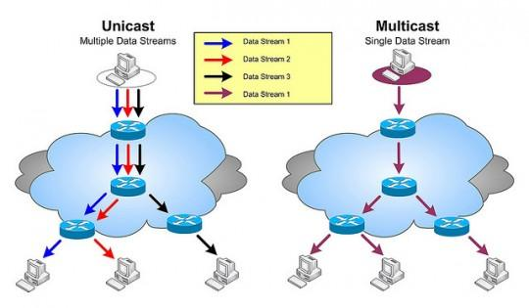
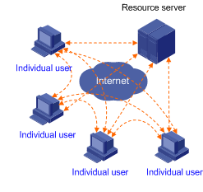
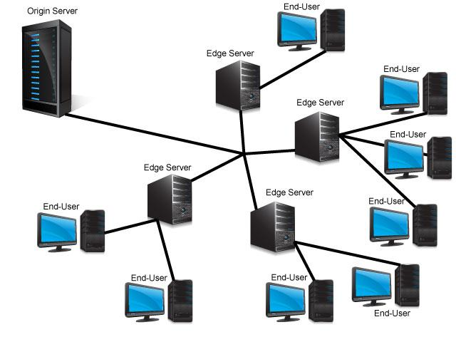
CDN Strategies
Unicast
Multicast
P2P
Cache-based
Traditional Unicast/Multicast
P2P
Cache Based

Slide 8
Evaluating media delivery networks
To evaluate any MDN strategy, we have to
Setup source/processing/relay/sink nodes on-demand
Transfer data across the ip backbone
Measure packet loss, latency etc.,
The “life-sized simulator” can do the above in a managed and distributed environment based on user input

Slide 9
System Design and Implementation
Notes:
Thanks Vinay. Today I am gonna walk through the architecture of the system.

Slide 10
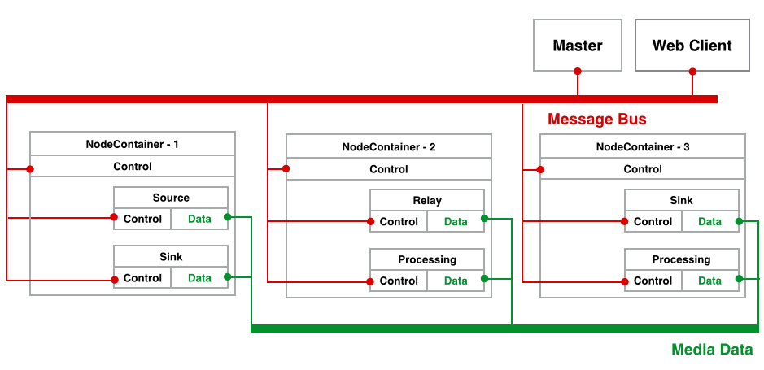
Overview of MDN Simulator
Notes:
Here is the overview of our system. As you can see in this figure, the major components of the system are Master, web client Node containers and nodes. As you can see, node containers are processes running on different machines. Nodes reside in node containers perform different functionalities. The red line indicates the message bus that connects all components together and passes control messages. And the green lines are the data path. This is for the purpose of transferring media data among different nodes. And we will go through the details in the following slides in this section.

Slide 11
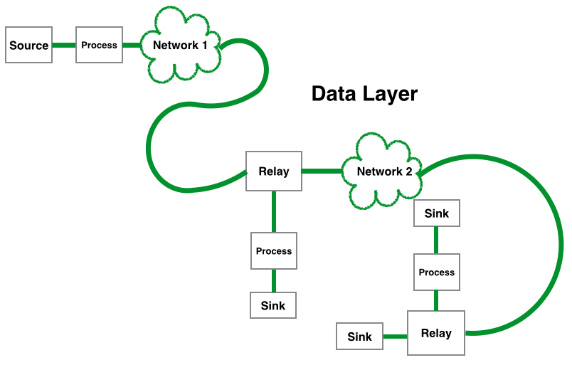
Anatomy of Simulator
Data Layer
Generate traffic
Process and deliver to clients
Use UDP
Management Layer
Control all components
Collect metrics
User Interface
Visualize network
Present metrics to user
Input to control simulation
Notes:
Now let’s take a closer look at the simulator. The simulator can be divided into 3 layers, those are data layer, management layer and user interface. As mentioned before, the responsibility of data layer is generating, processing and delivering data. The data layer uses UDP sockets to transfer the data.

Slide 12
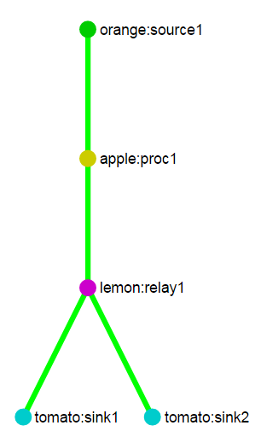
Anatomy of Simulator - Nodes
Source Node: Generate media data
Configurable size and bitrate
Processing Node: Perform operations on data
Consume CPU and Memory
Configurable processing load
Relay Node: Duplicate data and broadcast
Sink Node: Consume media data
The entity that requested the stream
Notes:
For data layer, four basic functionalities were identified and implemented. The first is the source node. Source node generates the media data for specific size and transfers data at specific bit rate. The data size and the bit rate are both configurable by users. And you can see in the right side of the screen, this graph is generated from the simulator which denotes a basic topology. The source node is circled by red. It is always the start of the media chain.

Slide 13
Anatomy of Simulator - Nodes
Source Node: Generate media data
Configurable size and bitrate
Processing Node: Perform operations on data
Consume CPU and Memory
Configurable processing load
Relay Node: Duplicate data and broadcast
Sink Node: Consume media data
The entity that requested the stream
Notes:
Then we move on to the processing node. Processing node simulates the actual processing on media data such as encoding, ads insertion. The simulator doesn’t perform the real operations. Instead, it simulates the CPU and memory utilization as media processings are computing intensive and we just need to consume some CPU and memory. As a result, this nodes introduces some latency to the data stream. As more stream flows to the same processing nodes, the more computing resources are required and therefore more latency may be introduced. And the circled component in the graph on the right side is a typical processing node. It takes one input and one output.

Slide 14
Anatomy of Simulator - Nodes
Source Node: Generate media data
Configurable size and bitrate
Processing Node: Perform operations on data
Consume CPU and Memory
Configurable processing load
Relay Node: Duplicate data and broadcast
Sink Node: Consume media data
The entity that requested the stream
Notes:
The relay node is one takes one input and duplicates the data and multicasts to different outputs. It does nothing but multicasting at application layer. As we will show in the demo, the relay node can dynamically add or remove some downstream nodes from the current media chain.

Slide 15
Anatomy of Simulator - Nodes
Source Node: Generate media data
Configurable size and bitrate
Processing Node: Perform operations on data
Consume CPU and Memory
Configurable processing load
Relay Node: Duplicate data and broadcast
Sink Node: Consume media data
The entity that requested the stream
Notes:
The last node is the sink node. The sink node is the node that initiates a request of a stream.Sink node consumes the media data. We use sink node calculates the end-to-end delay of the stream.

Slide 16
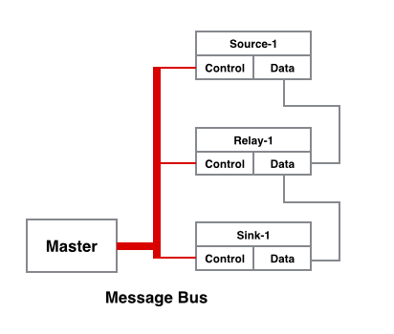
Anatomy of Simulator
Data Layer
Generate traffic
Process and deliver to clients
Management Layer
Control all components
Collect metrics
User Interface
Visualize network
Present metrics to user
Input to control simulation
Notes:
Now we move to the management layer. The management layer forms the backbone of the distributed systems and orchestrates components to perform the simulation. The management layer controls the whole system. And it is also in charge of collecting metrics from different components.

Slide 17
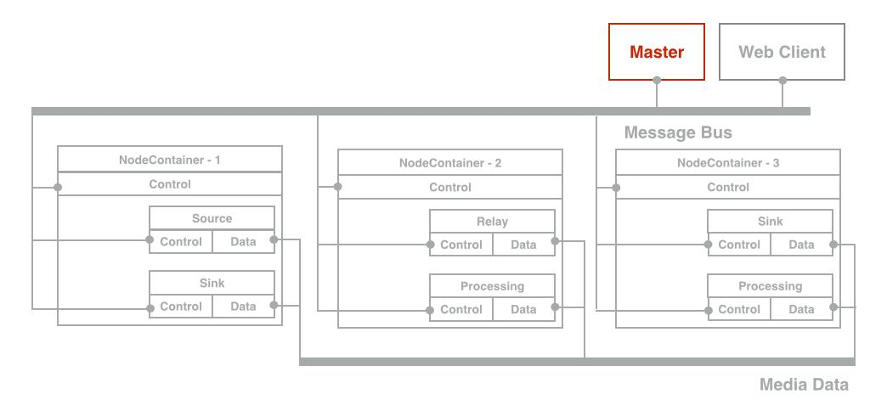
Anatomy of Simulator - Master
Instantiate nodes
Controls the simulation
Collects and aggregate statistics
Notes:
The first component in the simulator is the master node. The master is the core of whole systems. Master talks almost every component in the system directly. It talks to the webclient to receive the script of the simulation submitted by users and render the view to the front end. It talks to node containers to instantiate different nodes performing different functionalities. Once those nodes are ready for the simulation, it sends the control message to nodes to start the simulation, adds more loads to a stream, stop some stream or simply reset the whole system. And another important role master plays is to collect and aggregate the statistics from different components and provide the feedback.

Slide 18
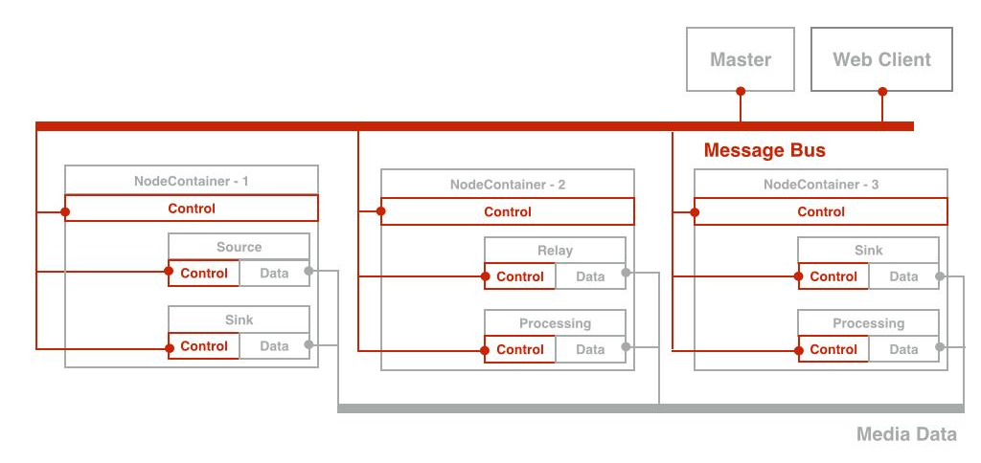
Anatomy of Simulator - Message Bus
Connect every components of the system
Channel for control messages
Channel for performance metrics
Notes:
And the message bus is another important component in the system. The message bus connects every component in the system and acts as the channel to send control.

Slide 19
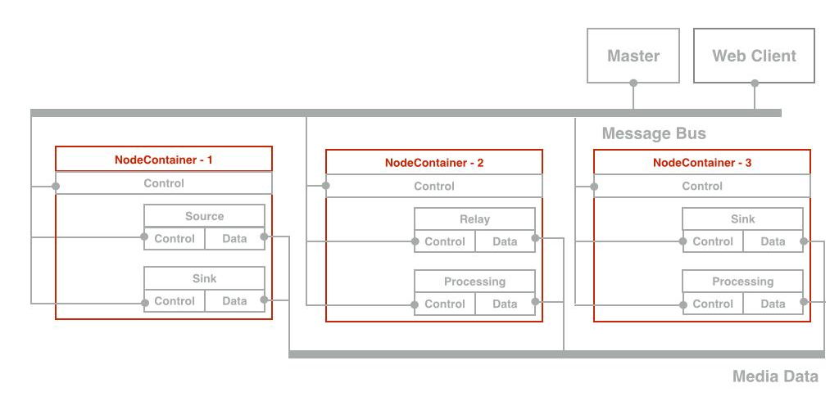
Anatomy of Simulator - Node Container
Represent one machine in deployment
Composite nodes
Be Configurable during runtime
Notes:
The last no the least, I will talk about the node container. Node containers are different processes running on different machines. The node container can host multiple nodes on different machines. The node containers provide a lot of flexibility to the system as each machine can be configured with several different functionalities. As you can see in the figure, a node container can host source and sink, or relay and processing and so on so forth. The functionalities are configured by the master during the runtime. Another good thing of this node container regards to the extensibility. When a new type of node is introduced to the system in the future, the new type of node can be easily host by the node container.

Slide 20
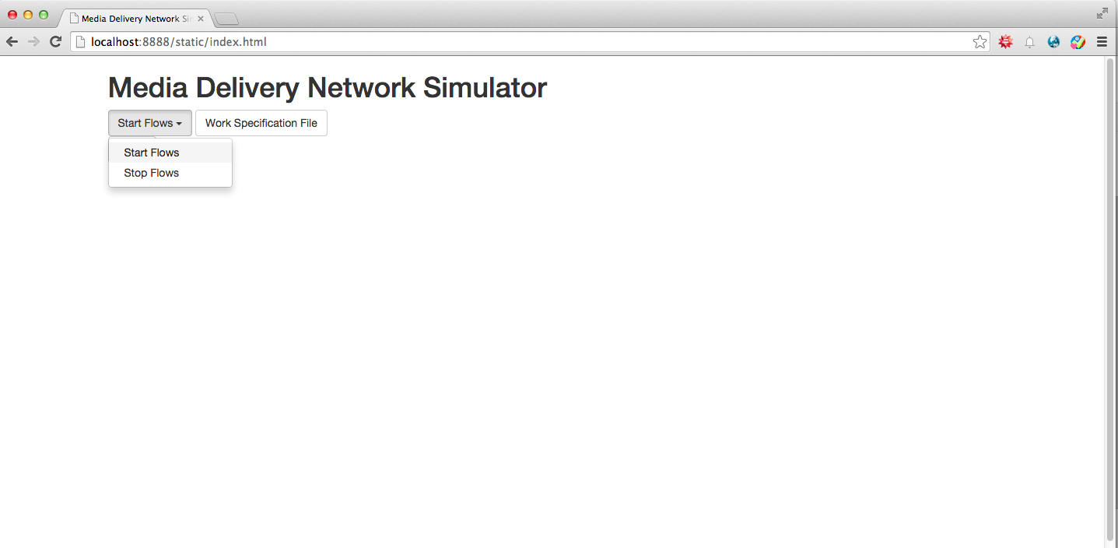
Anatomy of Simulator
Data Layer
Generate traffic
Process and deliver to clients
Management Layer
Control all components
Collect metrics
User Interface
Input to control simulation
Visualize network
Present metrics to user
Notes:
Now we will move to the last layer which is the user interface. The user interface is a web application. It provides the way to submitting a script of a simulation task, controlling the simulation such as add or decrease the load of a streams. It also visualize the topology of the network which is described in the submitted script. And it presents metrics collected from the system to users.

Slide 21
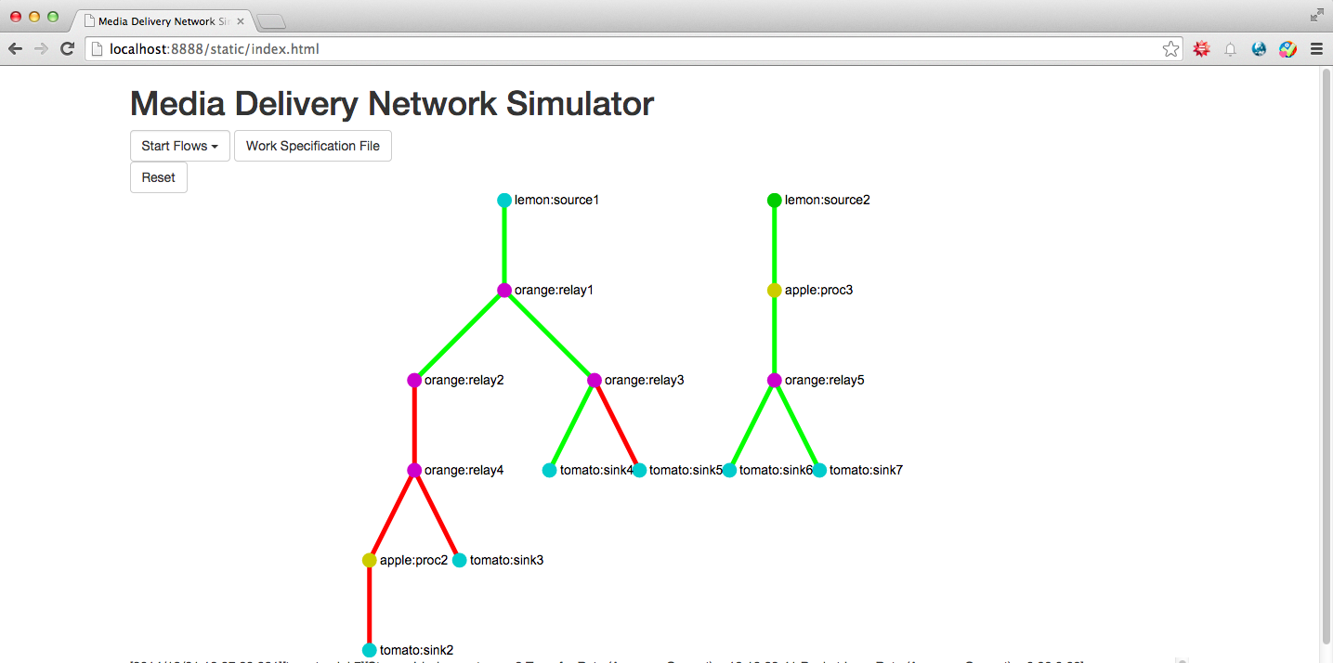
Anatomy of Simulator
Data Layer
Generate traffic
Process and deliver to clients
Management Layer
Control all components
Collect metrics
User Interface
Input to control simulation
Visualize network
Present metrics to user

Slide 22
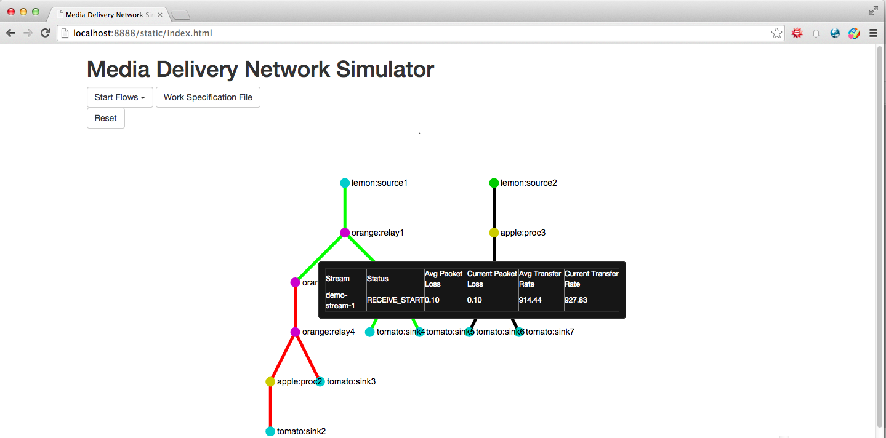
Anatomy of Simulator
Data Layer
Generate traffic
Process and deliver to clients
Management Layer
Control all components
Collect metrics
User Interface
Input to control simulation
Visualize network
Present metrics to user

Slide 23
Controlling Simulation
Work Specification
Start Simulation
Stop Simulation
Reset
Notes:
Work Specification: The input file given by the user that has a list of streams and stream parameters

Slide 24
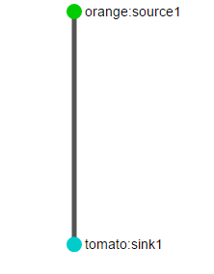
Work Specification Format - Simple
{
"SimId":"demo",
"StreamList":
[
{
"StreamId":"Stream1",
"DataSize":"20000000",
"KiloBitRate":"1000",
"FlowList":
[
{
"NodeList":
[
{
"NodeType":"SinkNode",
"NodeId":"tomato:sink1",
"UpstreamId":"orange:source1"
},
{
"NodeType":"SourceNode",
"NodeId":"orange:source1",
"UpstreamId":"NULL"
}
]
}
]
}
]
}
Notes:
Explain Stream, Flow
Node Id = Node Container + Node Id
UpStreamId
Stream: A unique media entity like a movie or audio clip that has a defined size and bitrate. A stream has a list of flows that have requested this stream Flow: A unique path that a stream follows from the source to sink

Slide 25
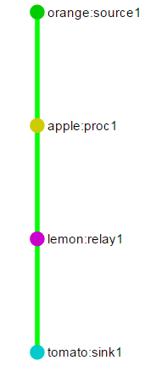
Work Specification - all node types
{
"SimId":"demo",
"StreamList":
[
{
"StreamId":"Stream1",
"DataSize":"20000000",
"KiloBitRate":"1000",
"FlowList":
[
{
"NodeList":
[
{
"NodeType":"SinkNode",
"NodeId":"tomato:sink1",
"UpstreamId":"lemon:relay1"
},
{
"NodeType":"RelayNode",
"NodeId":"lemon:relay1",
"UpstreamId":"apple:proc1"
},
.
.
.
.
{
"NodeType":"ProcessingNode",
"NodeId":"apple:proc1",
"UpstreamId":"orange:source1",
"ProcessingLoop":"100000",
"ProcessingMemory":"1000"
},
{
"NodeType":"SourceNode",
"NodeId":"orange:source1",
"UpstreamId":"NULL"
}
]
}
]
}
]
}
Notes:
Explain Processing Node - processing parameters
Relay Node
Again explain what is a Flow

Slide 26
Work Specification - Multiple Flows
{
"SimId":"demo",
"StreamList":
[
{
"StreamId":"Stream1",
"DataSize":"20000000",
"KiloBitRate":"1000",
"FlowList":
[
{
Flow 1 (same as previous slide)
},
{
"NodeList":
[
{
"NodeType":"SinkNode",
"NodeId":"tomato:sink2",
"UpstreamId":"lemon:relay1"
},
{
"NodeType":"RelayNode",
"NodeId":"lemon:relay1",
"UpstreamId":"apple:proc1",
},
{
"NodeType":"ProcessingNode",
"NodeId":"apple:proc1",
"UpstreamId":"orange:source1",
"ProcessingLoop":"100000",
"ProcessingMemory":"1000"
},
{
"NodeType":"SourceNode",
"NodeId":"orange:source1",
"UpstreamId":"NULL"
}
]
}
]
}
]
}
Notes:
Importance of Relay - add new flow to existing stream

Slide 27
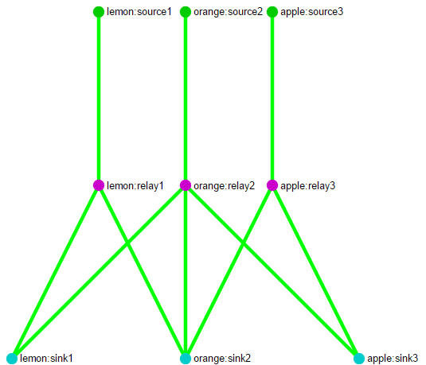
Peer 2 Peer Topology
Each Node Container
is considered as one peer
node of P2P network
Notes:
Here there are 3 Peers - Lemon, orange and apple. Lemon is sending some data to Orange and receiving some from it. Orange is sending and receiving data from/to all peers

Slide 28
Work Flow of the simulator
User uploads Work Specification
Master receives Work Specification
Updated Flow sent to Sink (for every flow in Work Specification)
Sink sets up listening port and forwards Flow to upstream
Source starts sending data
Periodic metric updates to master
Periodic update of Web Client
User
Web Client
Master
Sink
Source
1
2
3
4
5
6
6
7
Time
Time
Time
Time
Time

Slide 29
Work Flow of the simulator
User uploads Work Specification
Master receives Work Specification
Updated Flow sent to Sink (for every flow in Work Specification)
Sink sets up listening port and forwards Flow to upstream
Source starts sending data
Periodic metric updates to master
Periodic update of Web Client
User
Web Client
Master
Sink
Source
1
2
3
4
5
6
6
7
Time
Time
Time
Time
Time

Slide 30
Work Flow of the simulator
User uploads Work Specification
Master receives Work Specification
Updated Flow sent to Sink (for every flow in Work Specification)
Sink sets up listening port and forwards Flow to upstream
Source starts sending data
Periodic metric updates to master
Periodic update of Web Client
User
Web Client
Master
Sink
Source
1
2
3
4
5
6
6
7
Time
Time
Time
Time
Time

Slide 31
Work Flow of the simulator
User uploads Work Specification
Master receives Work Specification
Updated Flow sent to Sink (for every flow in Work Specification)
Sink sets up listening port and forwards Flow to upstream
Source starts sending data
Periodic metric updates to master
Periodic update of Web Client
User
Web Client
Master
Sink
Source
1
2
3
4
5
6
6
7
Time
Time
Time
Time
Time

Slide 32
Work Flow of the simulator
User uploads Work Specification
Master receives Work Specification
Updated Flow sent to Sink (for every flow in Work Specification)
Sink sets up listening port and forwards Flow to upstream
Source starts sending data
Periodic metric updates to master
Periodic update of Web Client
User
Web Client
Master
Sink
Source
1
2
3
4
5
6
6
7
Time
Time
Time
Time
Time

Slide 33
Work Flow of the simulator
User uploads Work Specification
Master receives Work Specification
Updated Flow sent to Sink (for every flow in Work Specification)
Sink sets up listening port and forwards Flow to upstream
Source starts sending data
Periodic metric updates to master
Periodic update of Web Client
User
Web Client
Master
Sink
Source
1
2
3
4
5
6
6
7
Time
Time
Time
Time
Time

Slide 34
Work Flow of the simulator
User uploads Work Specification
Master receives Work Specification
Updated Flow sent to Sink (for every flow in Work Specification)
Sink sets up listening port and forwards Flow to upstream
Source starts sending data
Periodic metric updates to master
Periodic update of Web Client
User
Web Client
Master
Sink
Source
1
2
3
4
5
6
6
7
Time
Time
Time
Time
Time

Slide 35
Demo

Slide 36
Contributions
Different elements(nodes) of the MDN
Extensible nodes
Actual data loads
Configurable traffic loads
Immediate feedback
Centralized control
Notes:
We have created different parts of MDN so we can simulate it
We design nodes in such a way that users can extend the them easily to do special processing
We use UDP to transfer data in the network instead of mathematical simulation
We allow users to specify parameters in configuration such as total data, transfer rate
We are collecting metrics and reporting to master where we can see the current state of the system through the UI
Set everything in master such as starting resetting, stopping flows; Easy to debug and maintain. Design stop some nodes but not implemented yet

Slide 37
Limitations
Manual deployment of node containers
Number of nodes in a node container
Manually coded Work Specification
Clock drift
Notes:
We have to manually start node containers before launching the whole system. If the amount of node contains is large, that will be a hard work.
We are using a thread so simulate a stream in a node. So the number of nodes contained in a node container is limited to number of threads that a JVM can handle
The work specification in JSON format needs to be written manually, so a small mistake of the spelling will lead to the failure of launching the system
If users want to launch thousands of streams, they need to user thousands of work specification
We are now making assumptions that the clocks in all nodes are the same. The clock on each node needs to be synchronized to get accurate latency figures.

Slide 38
Future Work
Node containers Auto-deployment
Maximum node number enhancement
Dynamic marker insertion in data traffic
Improvements in visualization part
UI based Work Specification generator
Notes:
We will working on writing a script to start node containers
One node only uses one thread; So the number of nodes the system can support will increase. per node per stream one thread now;
We will use a marker in traffic packets to induce processing and encoding workloads on processing nodes. So processing node will generate workload based on what is gotten in packet instead of fixed parameters in work specification
We will provide a better way to visualize a large number of nodes by providing some functions such as filtering the nodes; So user can see nodes within a specific stream, other nodes won’t be shown. All the nodes within one node container can be put together as a cluster in UI.
We will provide an UI to fill out html form to generate a work specification to avoid misspelling

Slide 39
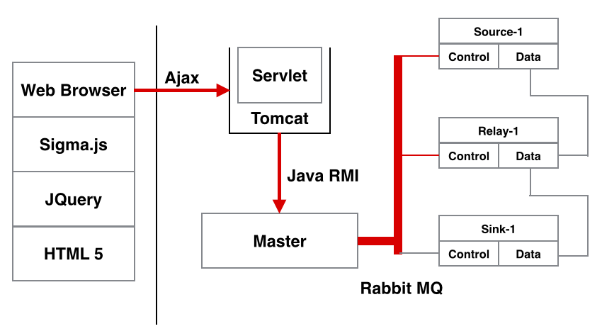
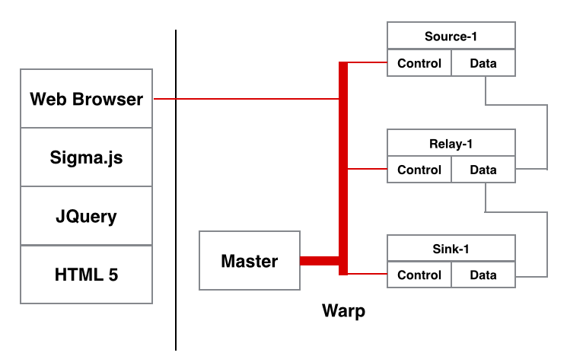
Tried and discarded
System Design & Development Progress
Initial Design & Implementation
Front-end: HTML5, JQuery, Sigma.js
Back-end: Tomcat, Java Servlet
Inter-process call:
Ajax
Java RMI
RabbitMQ
Evaluation of Initial Design
Multiple communication mechanisms
Too many dependencies
No unified interfaces for control messages

Slide 40
Tried and discarded
Ns2, Gns3 / NetSim, Mininet, Omnet++
Not Scalable: Simulations run on a single machine.
Nodes simulate L2 to L4 of the network stack and don't have functionality to simulate L7 processing.

Slide 41
Acknowledgement
We would like to thank Ericsson Research for sponsoring this project and providing us with this opportunity. We would like to specially thank Vlad, Jia and Alvin for guiding us through this project providing us with valuable feedback on design of the system.

Slide 42

Questions

Slide 43
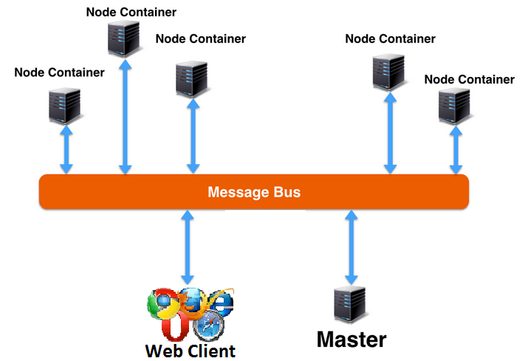
High Level View of MDN Simulator
Master
Control the system
Collect metrics
Web Client
Visualize nodes
Present metrics to user
Input - Control simulation
Node Container
Host and manage the nodes
Message Bus
Communication link between all components
Notes:
Master: The master is the core of whole systems. And we have node containers which act as slaves in the system run on different machines. Master communicates with node containers via the message bus to control the total system. Specifically, it controls the functionality of each node after the set up of the cluster. On the other hand, master can also collect performance metrics via message bus. The configurability of functionality during the runtime makes the systems flexible to deploy and the functionalities are interchangeable. Besides, this design also provides the extensibility as new functionalities can be added to the framework. And this figure also illustrates how the deployment will be in the real usage.
Each node container can also talk to each other as some control messages need to be passed among different node containers. In our implementation, we choose to use Warp library which eases this kind of communication. T

Slide 44
Components
Master Node: The server that instantiates/deploys the nodes, collects and aggregates statistics and controls the overall simulation
Web Client: The web interface that lets us interact with the system and visualize the state of the system
Message Bus: A decentralized messaging framework that lets us transfer control messages in a reliable manner separately from the data traffic
Node Containers: A remote process that hosts various node types of the simulation

Slide 45
Input
Work Specification: The input file given by the user that has a list of streams and stream parameters
Stream: A unique media entity like a movie or audio clip that has a defined size and bitrate. A stream has a list of flows that have requested this stream
Flow: A unique path that a stream follows from the source to sink

Slide 46
The IP Imperative
More than 90%of the world’s population will have access to mobile broadband by 2020
Global mobile data traffic is expected to grow over 10x by 2020 with video predicted to be 50% of all this traffic
In 2020, there are expected to be 15 billion video-enabled connected devices globally
And, in advanced markets, 50% of content watched is on-demand
[Source: http://www.ericsson.com/televisionary/blog/ericsson-media-vision-2020-game-changer-two-ip-imperative/]

Slide 47
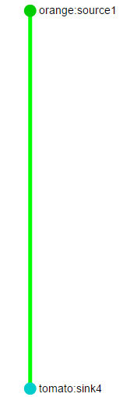
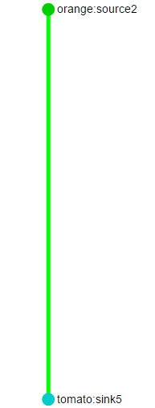
Work Specification - Multiple Streams
{
"SimId":"sim1",
"StreamList":
[
{
"StreamId":"Stream1",
"DataSize":"20000000",
"KiloBitRate":"1000",
"FlowList":
[
{
"NodeList":
[
{
"NodeType":"SinkNode",
"NodeId":"tomato:sink4",
"UpstreamId":"orange:source1"
},
{
"NodeType":"SourceNode",
"NodeId":"orange:source1",
"UpstreamId":"NULL"
}
]
}
]
},
{
"StreamId":"Stream2",
"DataSize":"20000",
"KiloBitRate":"50",
"FlowList":
[
{
"NodeList":
[
{
"NodeType":"SinkNode",
"NodeId":"tomato:sink5",
"UpstreamId":"orange:source2"
},
{
"NodeType":"SourceNode",
"NodeId":"orange:source2",
"UpstreamId":"NULL”
}
]
}
]
}
]
}

Slide 48
The IP Imperative
The number of IP connected devices that can view video has grown from 200 million (personal computers) to over 1.6 billion in the period 2000-2013 alone. In 2020, there are expected to be 15 billion video-enabled connected devices globally
Global data traffic is expected to grow over 10x by 2020 with video predicted to be 50% of all this traffic
And, in advanced markets, half of content watched is on-demand
[Source: http://www.ericsson.com/televisionary/blog/ericsson-media-vision-2020-game-changer-two-ip-imperative/]

